Slide 1
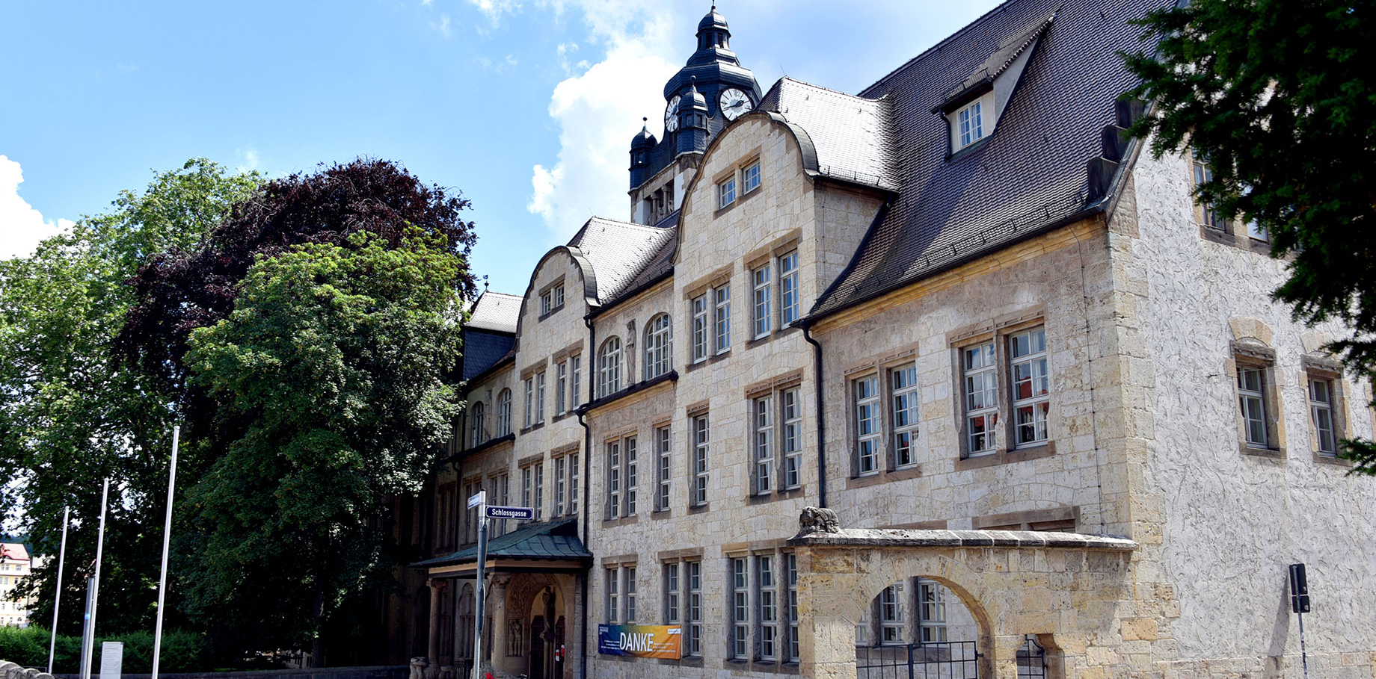
Camara enabled
Linear Encoder
Felix Fleisch, Bruno Reinhold AWP 3D Project
Foto: Anne Günther

Slide 2

Agenda
Motivation
Project Overview
Theoretical Concepts
Project Evaluation
Project Demonstration

Slide 3
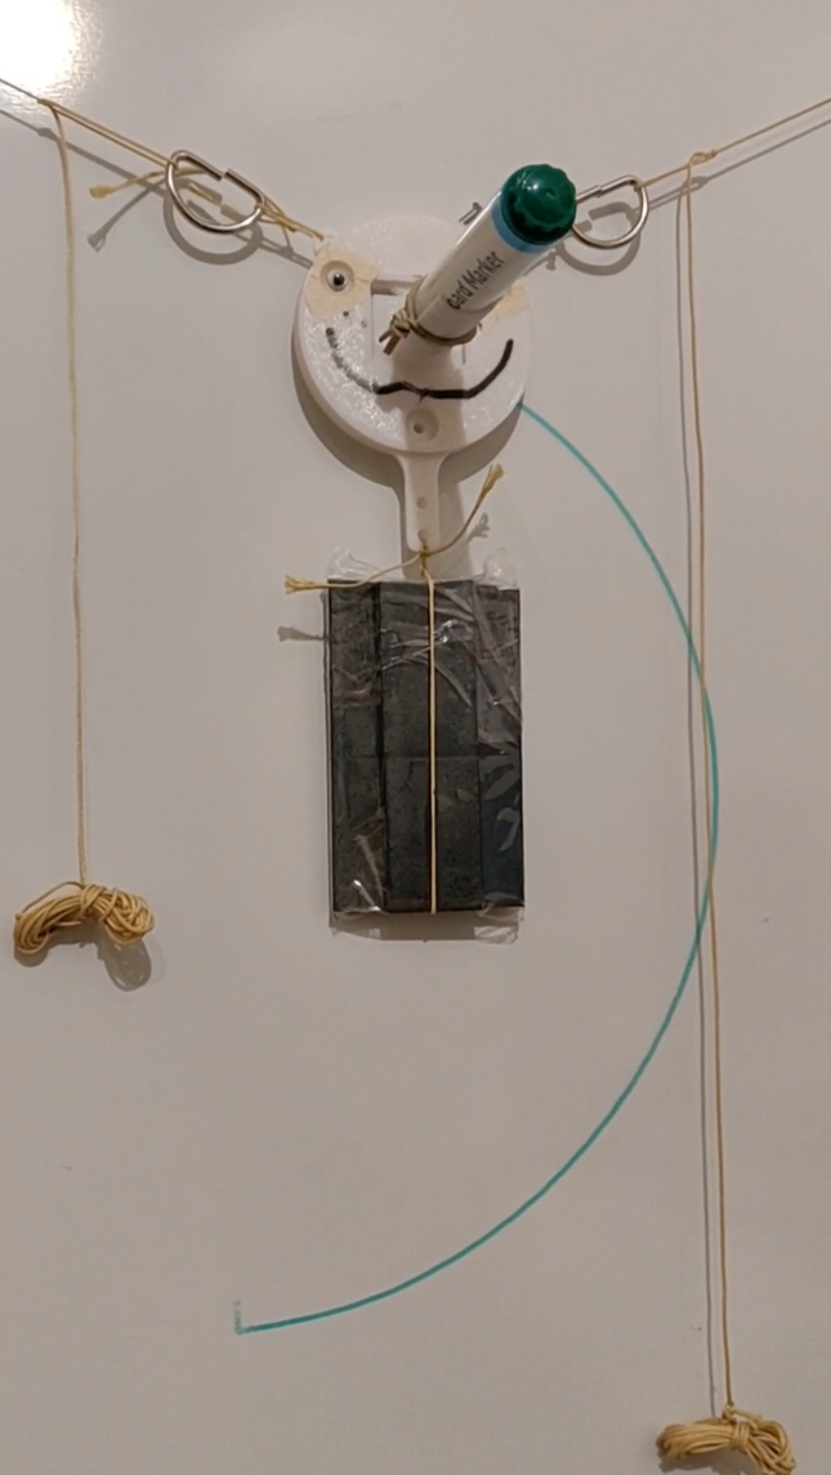
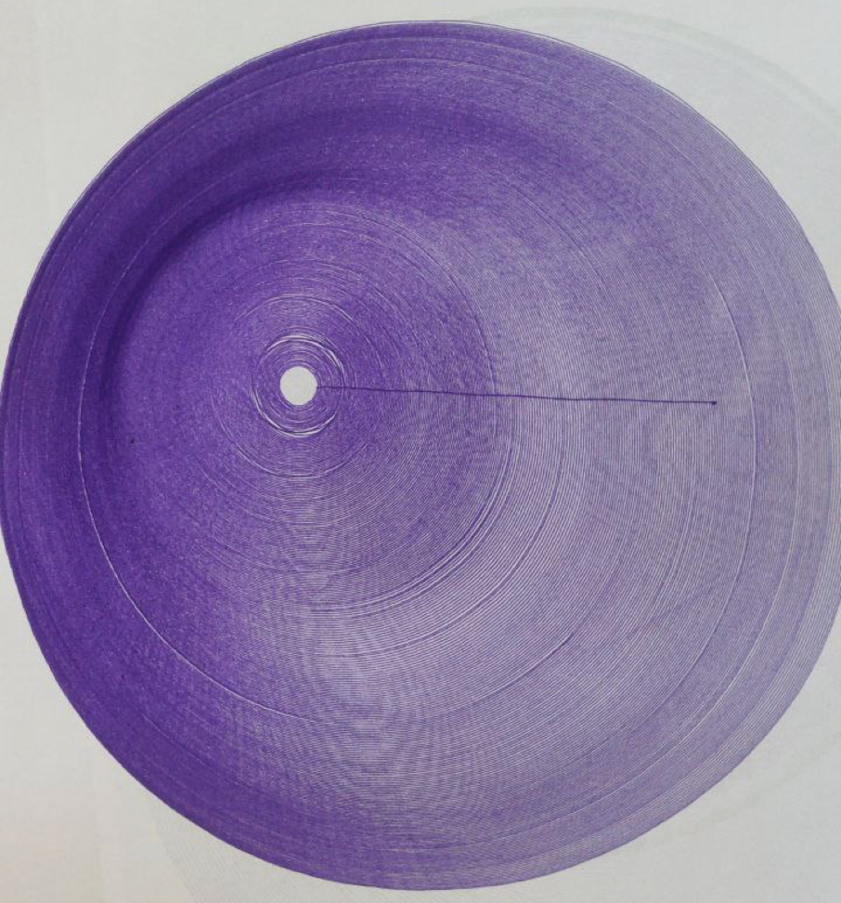
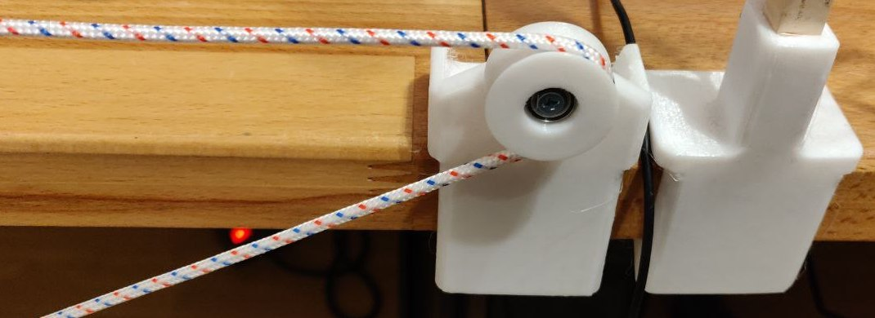
Motivation
idea:
-> develop linear encoder for 2D-plotter
problem:
-> ropes of the linear encoder slip over the pulley
-> small error builds up
-> the bigger the 2D-plotter gets the larger the error
solution:
-> encoding the movement of the rope to track the exact position
-> align assumed and actual position of the plotter head
Foto: Jan-Peter Kasper
Foto: Jan-Peter Kasper
Figure1: 2D-plotter head (top-left), erroneous plot (top-right), slipping pulley (bottom)

Slide 4
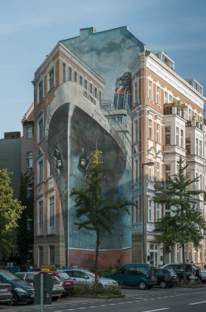
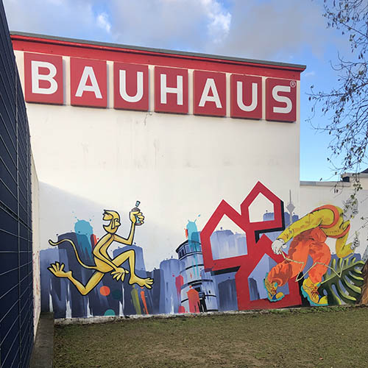
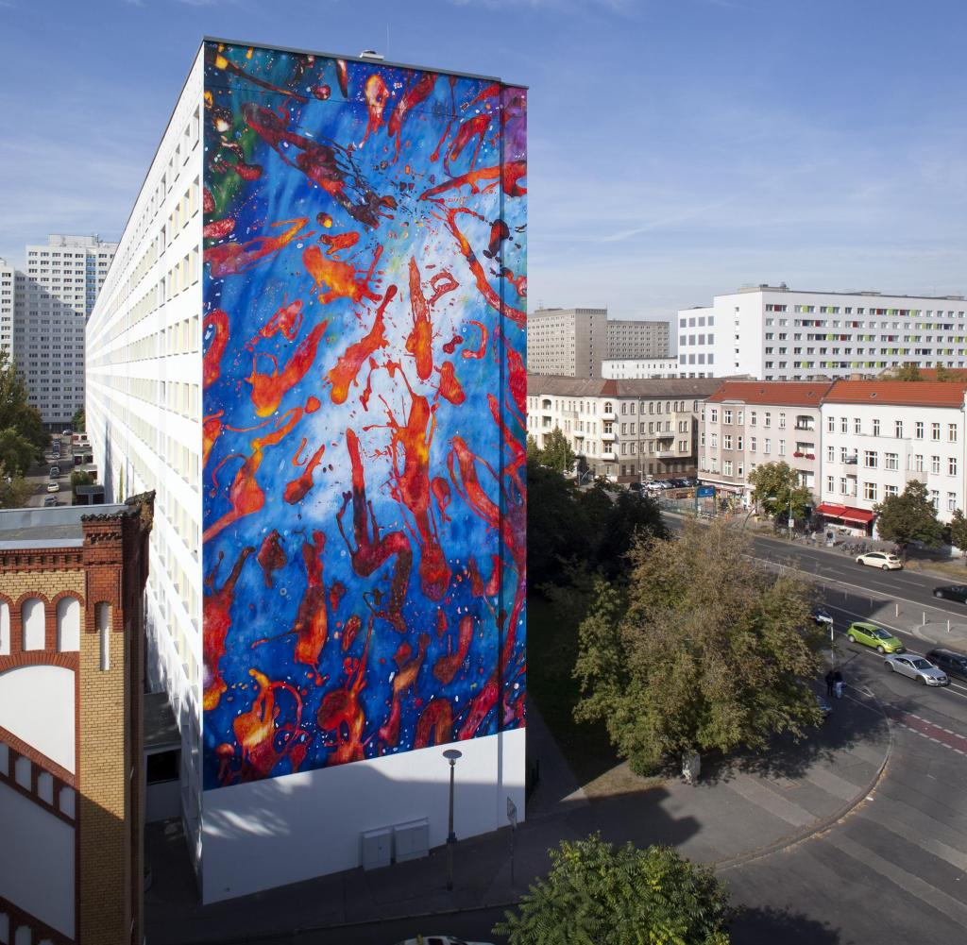
Motivation
Vision:
-> linear encoder scalable to
large plotter systems
-> painting on residential and
commercial buildings
(advertisement)
-> CNC – machines utilizing
ropes
Foto: Jan-Peter Kasper
https://www.sueddeutsche.de/geld/wandbilder-alles-fassade-1.3613836#
https://www.orig-ami.de/wp-content/uploads/2021/01/Graffitiauftrag_Bauhaus_2020_thumbnail.jpg
https://img.welt.de/img/finanzen/immobilien/mobile128119005/1852505567-ci102l-w1024/WS-Finanzen-Fassadenkunst.jpg
Figure 2: Examples of painted houses

Slide 5
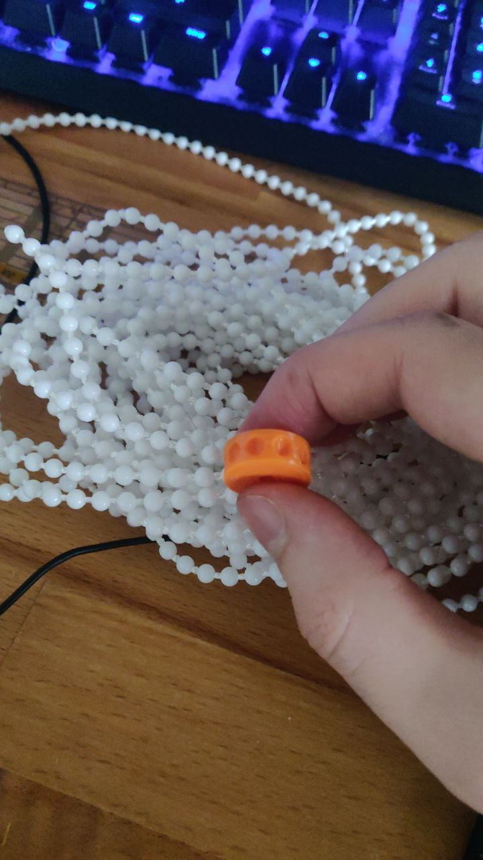
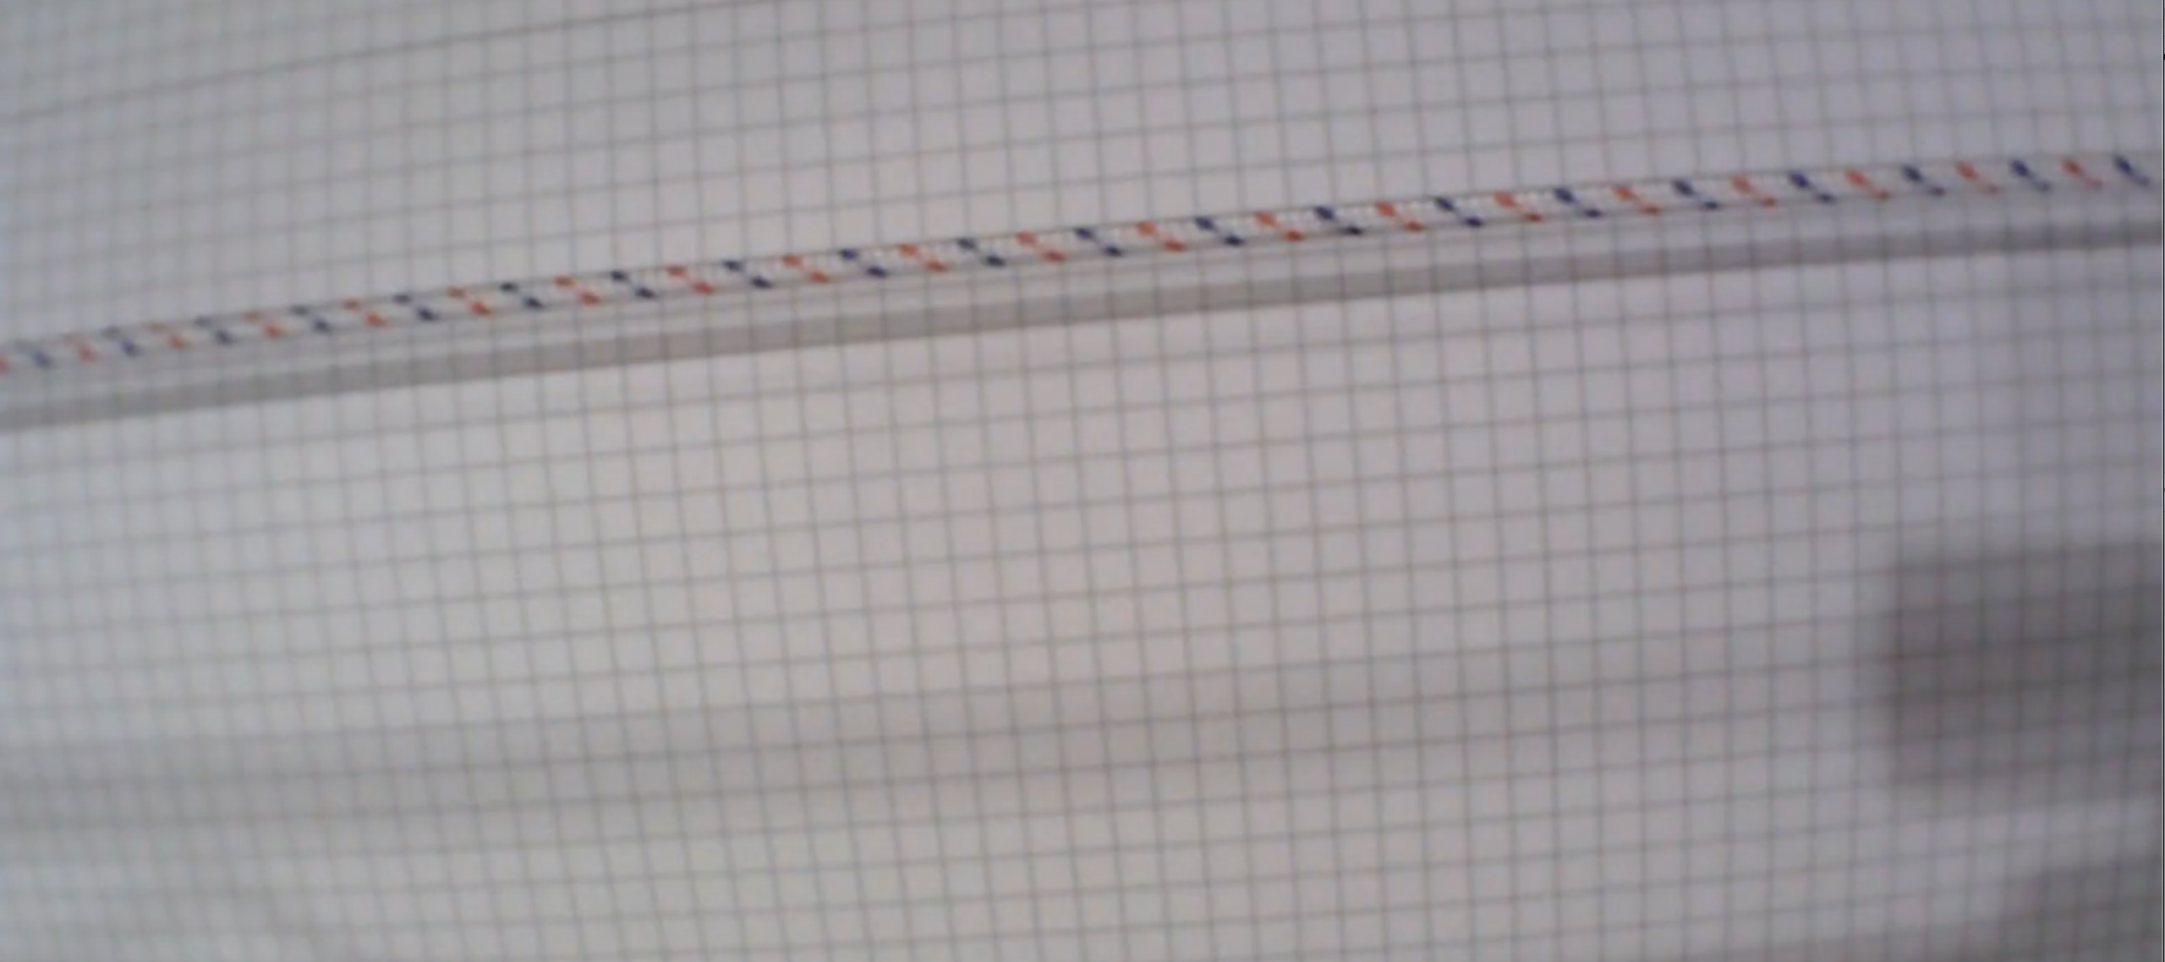
Project Overview
Goal of the project:
-> build a camara enabled linear encoder
software
-> applicable to ropes and chains
Foto: Jan-Peter Kasper
Figure 3: non-slipping chain (left), rope (right)

Slide 6
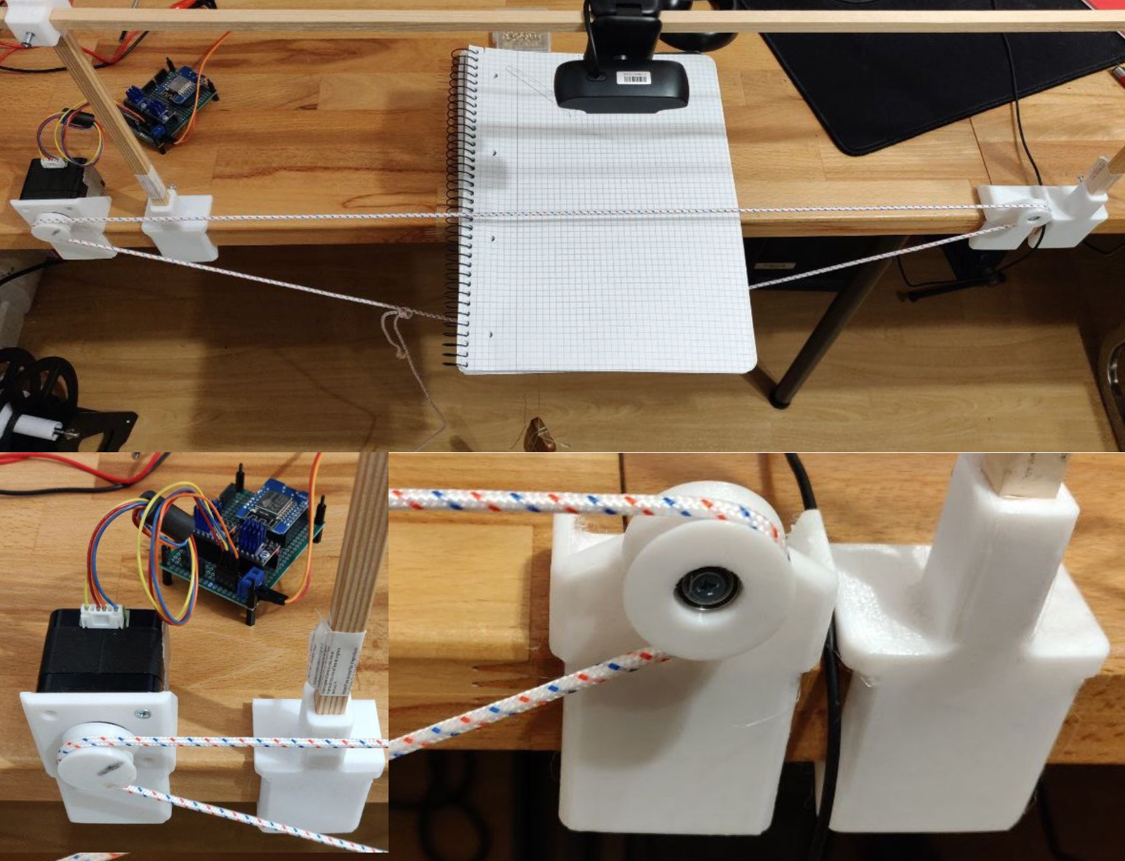
Project Overview
Roadmap:
1) Build Testbed for recording test footage
2) Developing the linear encoder prototype
2.1) Identify region of interest
2.2) detect shift of rope or chain
3) Refactor the prototype into a software library
Figure 4: testbed overview (top), left motor detail view (bottom left), pulley detail view (bottom right)

Slide 7
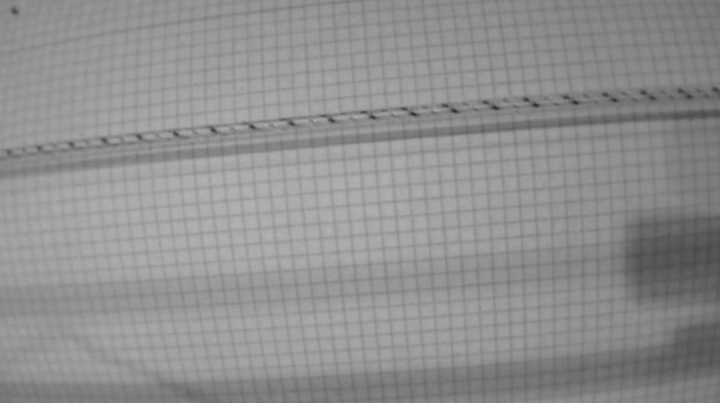
Theoretical Concepts
Limits of the Method
-> Nyquist-Shannon-Sampling Theorem
-> Encoding of rope possible up to certain speed
-> limited by framerate of camara
-> pattern on rope must be periodical
Figure 5: periodical pattern (red color channel)

Slide 8
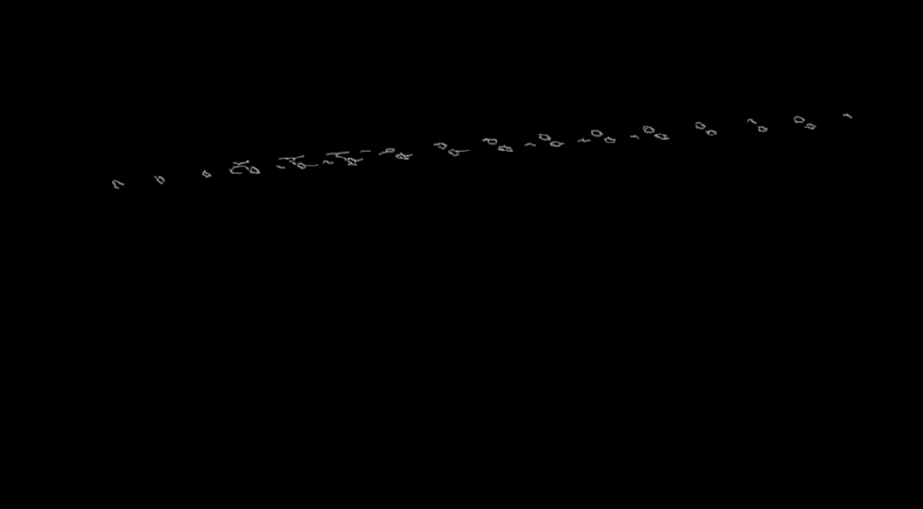
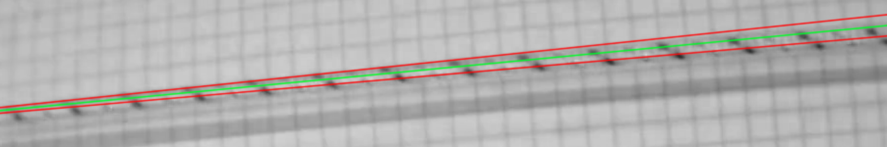
Theoretical Concepts
Identifying region of interest
-> Canny algorithm for edge detection
-> Hough lines through conjectured rope
-> rotation towards horizontal axis
-> cropped window around avg. Hough line
Figure 6: Canny edges (top), Hough Lines (middle channel), region of interest (bottom)

Slide 9
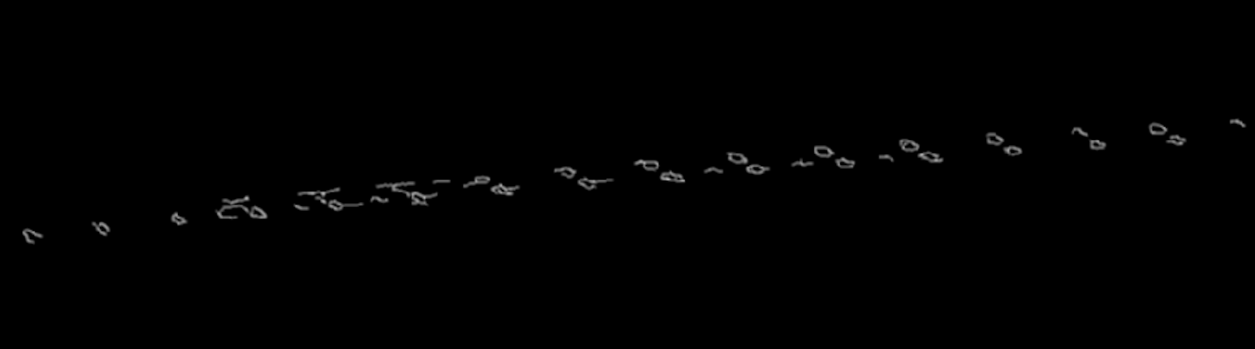
Theoretical Concepts
Canny algorithm
-> Gausian filtering
-> 5 x 5 Filter
-> detecting intensity gradients
-> Sobel filter
-> Non-Maximum Suppression
-> finding thin edges
-> Hysteresis Thresholding
Figure 7: Canny edges detail view

Slide 10
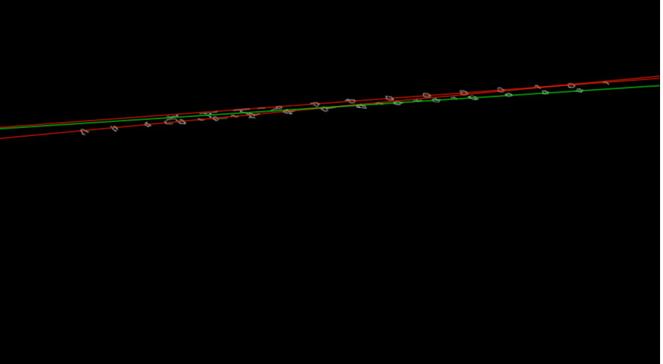
Theoretical Concepts
Hough lines
-> tracking intersections between curves of every
point (x, y)
-> number of intersections above threshold (th)
has line (θ,r_{θ}) through point (x, y)
Figure 8: Canny edges with examplary Hough Lines (top), Hough Lines in region of interes (Bottom)

Slide 11
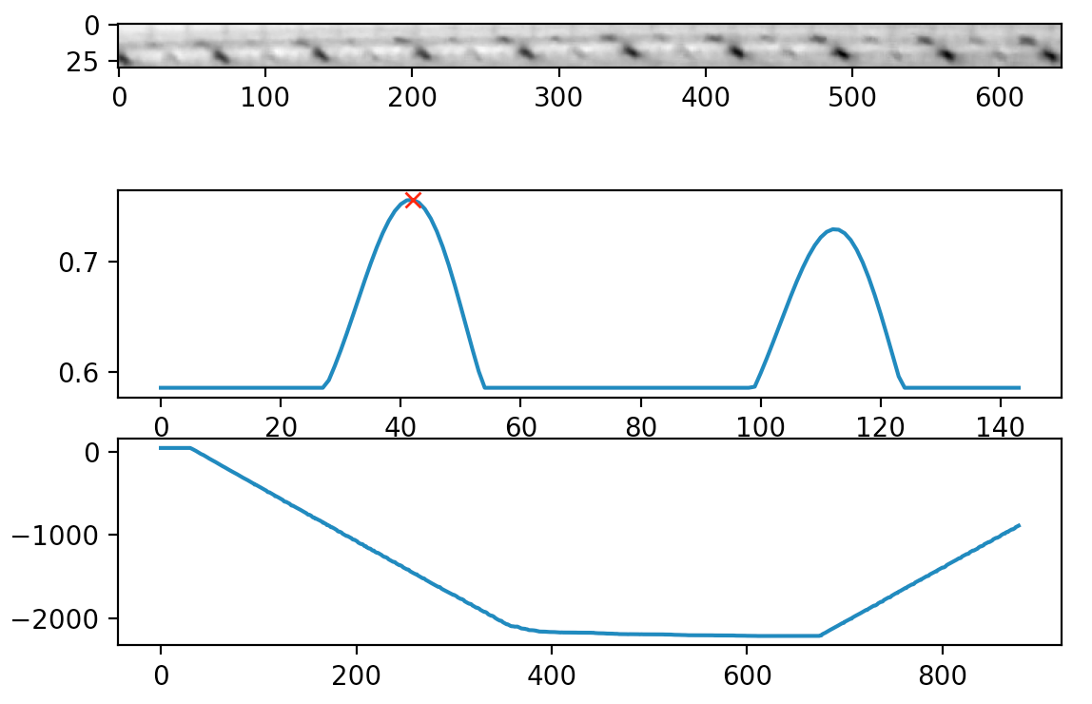
Theoretical Concepts
Encoding the rope:
-> determining the shift of the rope
-> correlating the pattern of the rope with ground
truth frame.
Correlation
distance
time

Slide 12
Project Evaluation
What works:
-> linear encoder is able to encode ropes
-> detecting slipping ropes
-> footage can have minor distractions
-> steady camera position required
-> good lighting conditions without changes

Slide 13
Project Evaluation
Future work:
-> resistance against axial rotating ropes
->
Figure 9: rotating spiral pattern desturbes rope encoding

Slide 14
Demo
Name des Referenten, Funktion

